Slide 1
Autonomous vehicles: the trolley problem and its consequences
Nina Papenfuß
25.02.2020

Slide 2
Structure
1.Introduction
1.1. Philosophical background
1.2. Relevance for AVs
2. The Moral Machine Experiment
2.1. Moral preferences
2.2. Individual variations based on demographics
2.3. Moral clusters
2.4. Cultural correlation
2.5. Consequences for a universal ethics
3. Conclusion & Outlook

Slide 3
Introduction
Thought experiment:
Simplify complex issues through hypothetical scenarios
“isolate and test desired variables” (Lin [7])

Slide 4
Introduction
Thought experiment:
Simplify complex issues through hypothetical scenarios
“isolate and test desired variables” (Lin [7])
Moral dilemma:
„the agent is required to do each of two (or more) actions; the agent can do each of the actions; but the agent cannot do both (or all) of the actions. The agent thus seems condemned to moral failure; no matter what she does, she will do something wrong (or fail to do something that she ought to do) (…) So in addition to the features mentioned above, in order to have a genuine moral dilemma it must also be true that neither of the conflicting requirements is overridden“ (SEP [A])

Slide 5
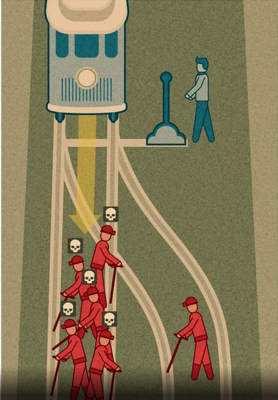
Philosophical Background
Philippa Foot 1967:
A trolley is out of control and about to roll over five persons on the track. Through pulling the switch the trolley could be diverted onto a different track. Unfortunately there is another person. Is it allowed to pull the switch and therefore accept the death of one person in order to save the lives of five persons? [B]
[C]
Notes:
Erklären
Ist Gedankenexperiment: 100% Sicherheit sterben, nur 2 Möglichkeiten usw
Ist trotzdem noch eine komplizierte Situation: pos und neg Pflichten (retten, nicht töten)
Ist Dilemma: Denn: Plicht nicht zu töten!

Slide 6
Philosophical Background
Cosequentialists: Switch
Philippa Foot 1967:
A trolley is out of control and about to roll over five persons on the track. Through pulling the switch the trolley could be diverted onto a different track. Unfortunately there is another person. Is it allowed to pull the switch and therefore accept the death of one person in order to save the lives of five persons? [B]
[C]

Slide 7
Philosophical Background
Cosequentialists: Switch
Philippa Foot 1967:
A trolley is out of control and about to roll over five persons on the track. Through pulling the switch the trolley could be diverted onto a different track. Unfortunately there is another person. Is it allowed to pull the switch and therefore accept the death of one person in order to save the lives of five persons? [B]
Double Effect: Switch
[C]

Slide 8
Philosophical Background
Cosequentialists: Switch
Philippa Foot 1967:
A trolley is out of control and about to roll over five persons on the track. Through pulling the switch the trolley could be diverted onto a different track. Unfortunately there is another person. Is it allowed to pull the switch and therefore accept the death of one person in order to save the lives of five persons? [B]
Double Effect: Switch
Deontic Logic: notSwitch
[C]
Notes:
- Unterschied zwischen “Letting die” and “killing”

Slide 9
Philosophical Background
Somewhat analogous for AV
Cosequentialists: Switch
Philippa Foot 1967:
A trolley is out of control and about to roll over five persons on the track. Through pulling the switch the trolley could be diverted onto a different track. Unfortunately there is another person. Is it allowed to pull the switch and therefore accept the death of one person in order to save the lives of five persons?
Double Effect: Switch
Deontic Logic: notSwitch
[C]
Notes:
Häufigkeit: schwer zu berechnen
AV versucht Situationen zu vermeiden -> trotzdem Unfalloptimierung!

Slide 10
Relevance for AVs
According to an AV’s calculation, it is about to roll over five persons if it stays on its lane. By swerving the AV would hit another person. Is the AV allowed to swerve and therefore bring by the death of one person in order to save the lives of five persons?
[C]

Slide 11
Relevance for AVs
Cosequentialists: Switch
According to an AV’s calculation, it is about to roll over five persons if it stays on its lane. By swerving the AV would hit another person. Is the AV allowed to swerve and therefore bring by the death of one person in order to save the lives of five persons?
[C]

Slide 12
Relevance for AVs
Cosequentialists: Switch
According to an AV’s calculation, it is about to roll over five persons if it stays on its lane. By swerving the AV would hit another person. Is the AV allowed to swerve and therefore bring by the death of one person in order to save the lives of five persons?
Double Effect possible?
[C]

Slide 13
Relevance for AVs
Cosequentialists: Switch
According to an AV’s calculation, it is about to roll over five persons if it stays on its lane. By swerving the AV would hit another person. Is the AV allowed to swerve and therefore bring by the death of one person in order to save the lives of five persons?
Double Effect possible?
Deontic Logic: notSwitch
[C]

Slide 14
Relevance for AVs
Cosequentialists: Switch
According to an AV’s calculation, it is about to roll over five persons if it stays on its lane. By swerving the AV would hit another person. Is the AV allowed to swerve and therefore bring by the death of one person in order to save the lives of five persons?
Double Effect possible?
Deontic Logic: notSwitch
Flip a coin?
[C]
Notes:
Mehrere Optionen:
-> Umgang muss diskutiert warden
Nicht von einem Expertengremium, sondern in der Gesellschaft! Und vor allem TRANSPARENT
Ist wichtig, damit Avs auch akzeptiert werden
Eine Art der gesellschaftlichen Debatte: Moral Machine

Slide 15
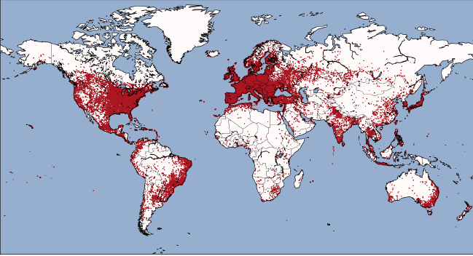
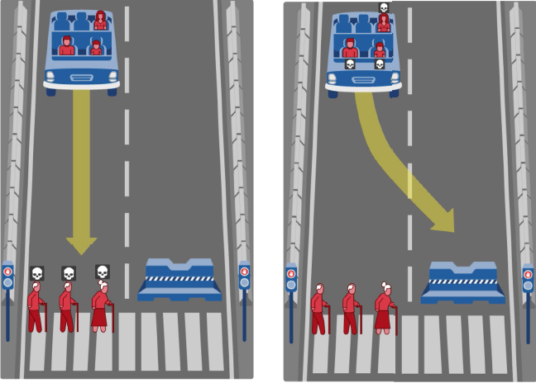
The Moral Machine Experiment
Website: http://moralmachine.mit.edu
2.3 Million self-selected participants
All information of this slide: [1]

Slide 16
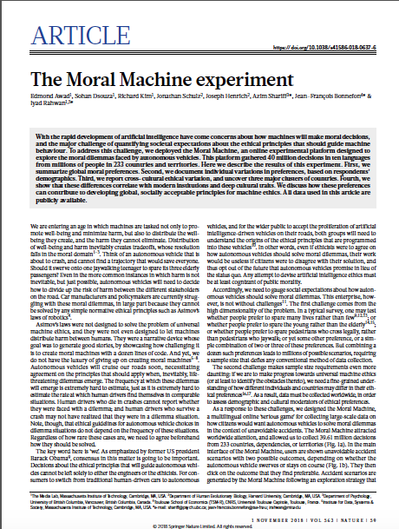
Awad, Dsouza, Kim, Schulz, Henrich, Shariff, Bonnefon, Rahwan 2018 [1]
Notes:
Scalable Cooperation Group at MIT, Leitung Iyad Rahwans

Slide 17
1. Moral preferences
2. Individual variations based on demographics
3. Cultural cluster
4. Cultural correlation

Slide 18
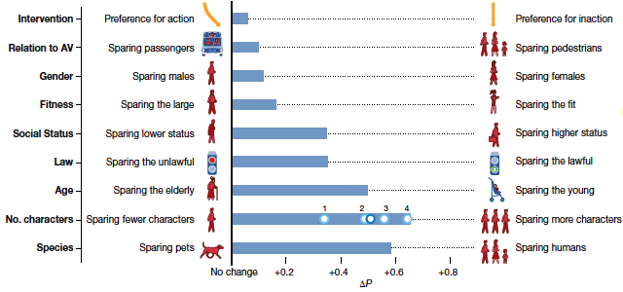
Moral preferences
Average Minimal Component Effect (AMCE) [1]

Slide 19
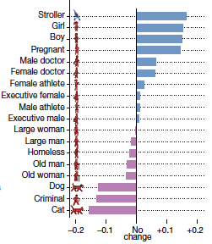
Moral preferences
Average Minimal Component Effect (AMCE) [1]
Relative advantage/penalty [1]

Slide 20
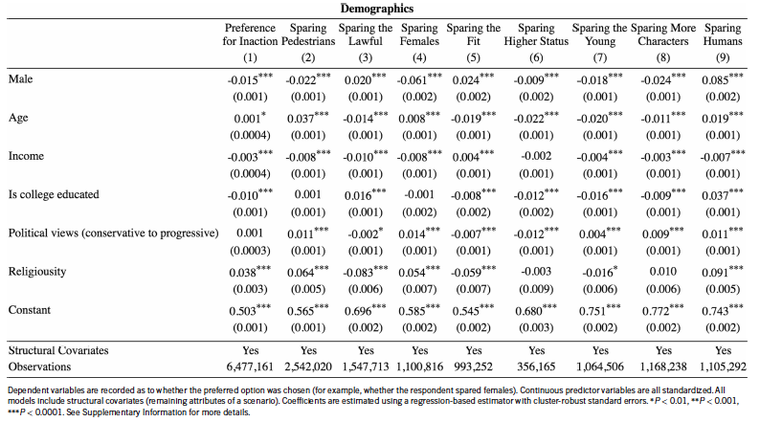
Individual variations based on demographics
Regression table showing the individual variations for each of the nine attributes [1]

Slide 21
Individual variations based on demographics
No sizable impact
Regression table showing the individual variations for each of the nine attributes [1]
Notes:
Kein nennenswerter Einfluss der individuellen Variationen
Nirgends warden gegensetzliche Präferenzen berechnet
-> Frauen schonen Frauen eher, aber Männer schonen sie auch, nur weniger.

Slide 22
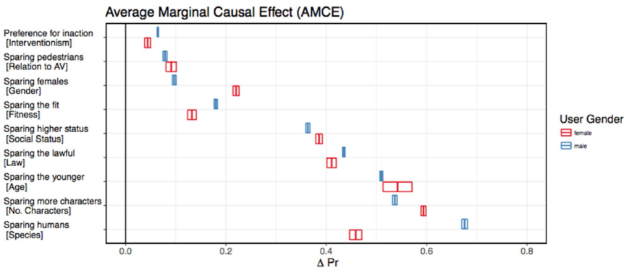
Individual variations based on demographics
[1]

Slide 23
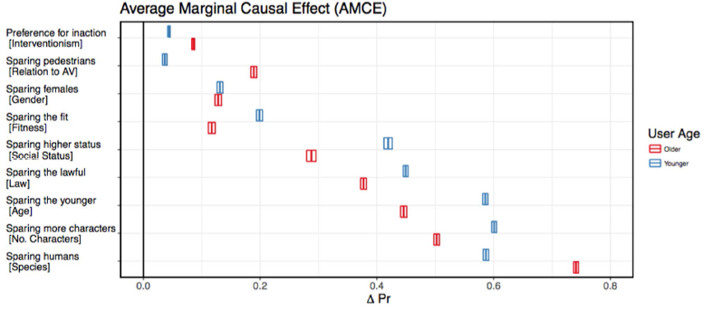
Individual variations based on demographics
[1]

Slide 24
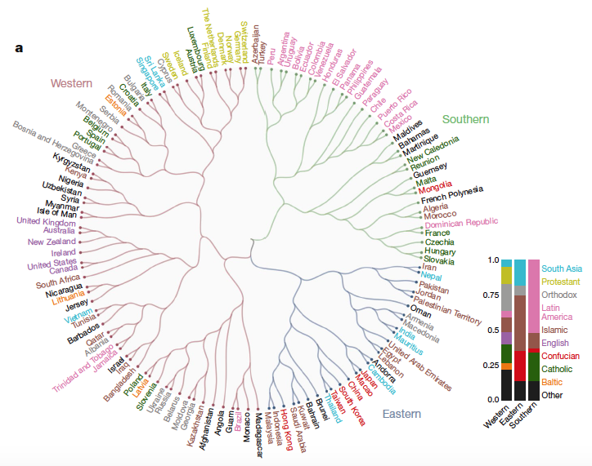
Cultural clusters
Hierarchical cluster of countries based on AMCE [1]
Notes:
Westlicher Cluster:
- Nordamerika + Europa, christlich
Innere Struktur: skandinavische Länder, Commonwealth
Östlicher Cluster:
Ost und Südostasien -> konfuzianische Kulturgruppe
Arabische Länger
Südlicher Cluster:
- Latein- und Mittelamerika
-innen: Rosa! Und französisches Einflussgebiet
Ingelhardt-Welzel Kulturkarte
(mit Euklischem Abstand und Ward’s Minimum Variance Method)

Slide 25
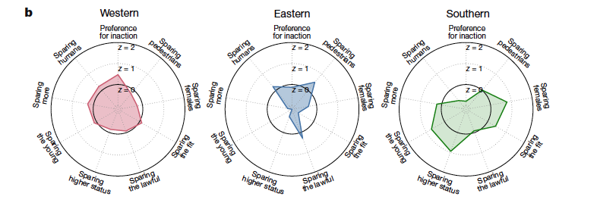
Cross-cluster differences
Mean AMCE z-scores [1]
Notes:
Jung alt: bei östlich vs südlich krass
Südlich: Frauen und keine Menschen
Hoher Status: südlich krass, östlich sehr wenig
Bei allen: schwache Präferenz: Fußgänger > Autoinsassen
Und die Gesetztestreuen eher schonen

Slide 26
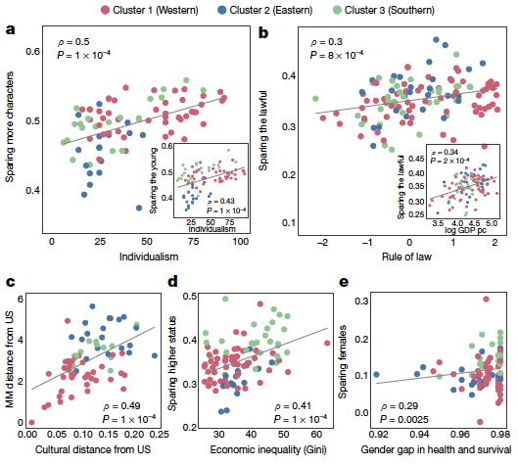
Moral and cultural correlation
Association between Moral Machine preferences and other variables at the country level (Spearman’s ρ and Ρ values) [1]
Notes:
Frage: Inwiefern korrellieren moralische Vorlieben mit kulturellen und wirtschaftlichen Eigenheiten?
Ein paar Beispiele:
Eins z.B. Je individualistischer die Gesellschaft, desto eher rettet sie mehr Menschen
Vs. Kollektivistische Länder schonen weniger die jungen Menschen
Überleitung: Kulturelle Differenzen müssen weiter erforscht werden -> wichtig: Umfrage nicht repräsentativ, und zw. 100-500.000 Unterschied..
Zurück zum Dilemma und den globalen Vorlieben: 3 Stück festgestellt

Slide 27
Consequences for a universal ethics
1. Human > Pet

Slide 28
Consequences for a universal ethics
1. Human > Pet
2. Sparing more people

Slide 29
Consequences for a universal ethics
1. Human > Pet
2. Sparing more people
3. Young > Old

Slide 30
Consequences for a universal ethics
1. Human > Pet
2. Sparing more people
Ethik-Kommission 2017:
Der „Schutz menschlichen Lebens in einer Rechtsgüterabwägung [besitzt] höchste Priorität. Die Programmierung ist deshalb im Rahmen des technisch Machbaren so anzulegen, im Konflikt Tier- oder Sachschäden in Kauf zu nehmen, wenn dadurch Personenschäden vermeidbar sind.“ [D]
3. Young > Old

Slide 31
Consequences for a universal ethics
1. Human > Pet
2. Sparing more people
Ethik-Kommission 2017:
„(…)Eine Aufrechnung von Opfern ist untersagt. Eine allgemeine Programmierung auf eine Minderung der Zahl von Personenschäden kann vertretbar sein. Die an der Erzeugung von Mobilitätsrisiken Beteiligten dürfen Unbeteiligte nicht opfern.“ [D]
3. Young > Old

Slide 32
Consequences for a universal ethics
1. Human > Pet
2. Sparing more people
Ethik-Kommission 2017:
„Bei unausweichlicher Unfallsituation ist jede Qualifizierung nach persönlichen Merkmalen (Alter, Geschlecht, körperliche oder geistige Konstitution) strikt untersagt.“ [D]
3. Young > Old
Notes:
Muss reflektiert werden! Damit es keinen Backlash gibt, wenn ein Kind umkommt.
Wie geht es jetzt weiter?
(Luftsicherheitsgesetz: Am 15. Februar 2006 entschied das Bundesverfassungsgericht, dass § 14 Abs. 3 LuftSiG gegen das Grundrecht auf Leben (Art. 2 Abs. 2 Grundgesetz) und gegen die Menschenwürde (Art. 1 GG) verstößt und deshalb insoweit verfassungswidrig und nichtig ist)

Slide 33
Conclusion
Ethical principles for AVs – especially concerning moral dilemmas - need to be discussed collectively and democratically (no correct/moral answer, only way to guarantee acceptance).
Empirical research about moral preferences should only be one tool and should be used with caution (bias, positivism).
The debate needs to be embedded in a debate on who is prioritized on the streets (statistical dilemma [3]) and include even more factors (e.g. ecological).
At the moment there is a tilt in the debate (See: Greene et al. [5], Jobin et al.[6])
Notes:
„These are not the dramatic, life and death decisions featured in trolley dilemmas. But once they are aggregated over millions of cars driving billions of miles, these small sttistical decisions add up to life and death consequences“
„Instead of asking wether one passenger should die to save five pedestrians in a given crash, we would ask wether one passenger should die for five pedestrians, across all the crashes recordd in a single year“
Wir wollen, dass autonome Autos Unfälle verhindern. Aber es ist unklar wie die Unfälle, die passieren, verteilt werden sollen → dilemma auf statistischer Ebene
Zu Punkt 4: Wie wird über Moral geredet/was wird darunter gefasst
Tendenziell warden rein technische Lösungen gesucht
Wenig Beachtung: Soziale Gerechtigkeit und Gleichheit
Un: the global landscape of guidelines
“Sustainability, dignity, and solidarity are significantly underrepresented compared to other ethical dimensions”
Aus dem Papier der Ethikkommission:
1) Autonomes Fahren dient „zuerst der Verbesserung der Sicherheit aller Beteiligten im
Stra.enverkehr. Daneben geht es um die Steigerung von Mobilit.tschancen und die
Erm.glichung weiterer Vorteile“
2) „(...)Die Zulassung von automatisierten Systemen ist nur vertretbar, wenn sie im Vergleich
zu menschlichen Fehlleistungen zumindest eine Verminderung von Sch.den im Sinne einer
positiven Risikobilanz verspricht.“

Slide 34
Outlook
Awad, Dsouza, Shariff, Rahwan, Bonnefon: Universals and variations in moral decisions made 42 countries by 70,000 participants. 01/2020.[2]

Slide 35
Bibliography
[1] Awad, E., Dsouza, S., Kim, R., Schulz, J., Henrich, J., Shariff, A., Bonnefon J.-F., Rahwan, I.: The Moral Machine Experiment. In: Nature 563, pp. 59-64 (2018).
[2] Awad, E., Dsouza, S., Kim, R., Schulz, J., Henrich, J., Shariff, A., Bonnefon J.-F., Rahwan, I.: Universals and variations in moral decisions made 42 countries by 70,000 participants. In: PNAS 117, pp. 2332-2337 (2020).
[3] Bonnefon, J.-F., Shariff, A., Rahwan, I.: The trolley, the bull bar, and why engineers should care about the ethics of autonomous cars. In: Proceedings of the IEEE 107, pp. 502-504 (2019).
[4] Crawford, K., Calo, R.: There is a blind spot in AI research. In: Nature 538, pp.311-313 (2016).
[5] Greene, D., Hoffmann, A. L., Stark, L.: Better, Nicer, Clearer, Fairer: A Critical Assessment of the Movement for Ethical Artificial Intelligence and Machine Learning. In: Proc. 52nd Hawaii International Conference on System Sciences, pp. 2122-2131 (2019).
[6] Jobin, A., Ienca, M., Vayena, E.: The global landscape of AI ethics guidelines. In: Nature Machine Intelligence 1, pp. 389-399 (2019).
[7] Lin, Patrick: „Why Ethics matters“. In: Autonomes Fahren, Maurer, Gerdes et al, 2015.
[8] Thomson, J. J.: The trolley problem. In: Yale Law Journal 94, pp. 1395-1415 (1985).
[9] Winfield, A.F., Michael, K., Pitt, J., Evers, V.: Machine Ethics: The Design and Gouvernance of Ethical AI and Autonomous Systems. In: Proceedings of the IEEE 107, pp. 509-517 (2019).

Slide 36
Online-Quellen
[A] https://plato.stanford.edu/entries/moral-dilemmas/ (SEP)
[B] https://plato.stanford.edu/entries/philippa-foot/
[C] https://www.spiegel.de/wissenschaft/mensch/trolley-problem-wuerden-sie-einen-menschen-opfern-um-fuenf-andere-zu-retten-a-f7714fe4-a8c4-440c-989e-e7de9f669d04#
[D] https://www.bmvi.de/SharedDocs/DE/Publikationen/DG/bericht-der-ethik-kommission.html

